Slide 1


FPV RC CAR
WiFi Controlled Robot with Live Video Stream
Edgar Gutierrez
ECE 528L - Robotics and Embedded Systems
Instructor: Aaron Nanas

Slide 2
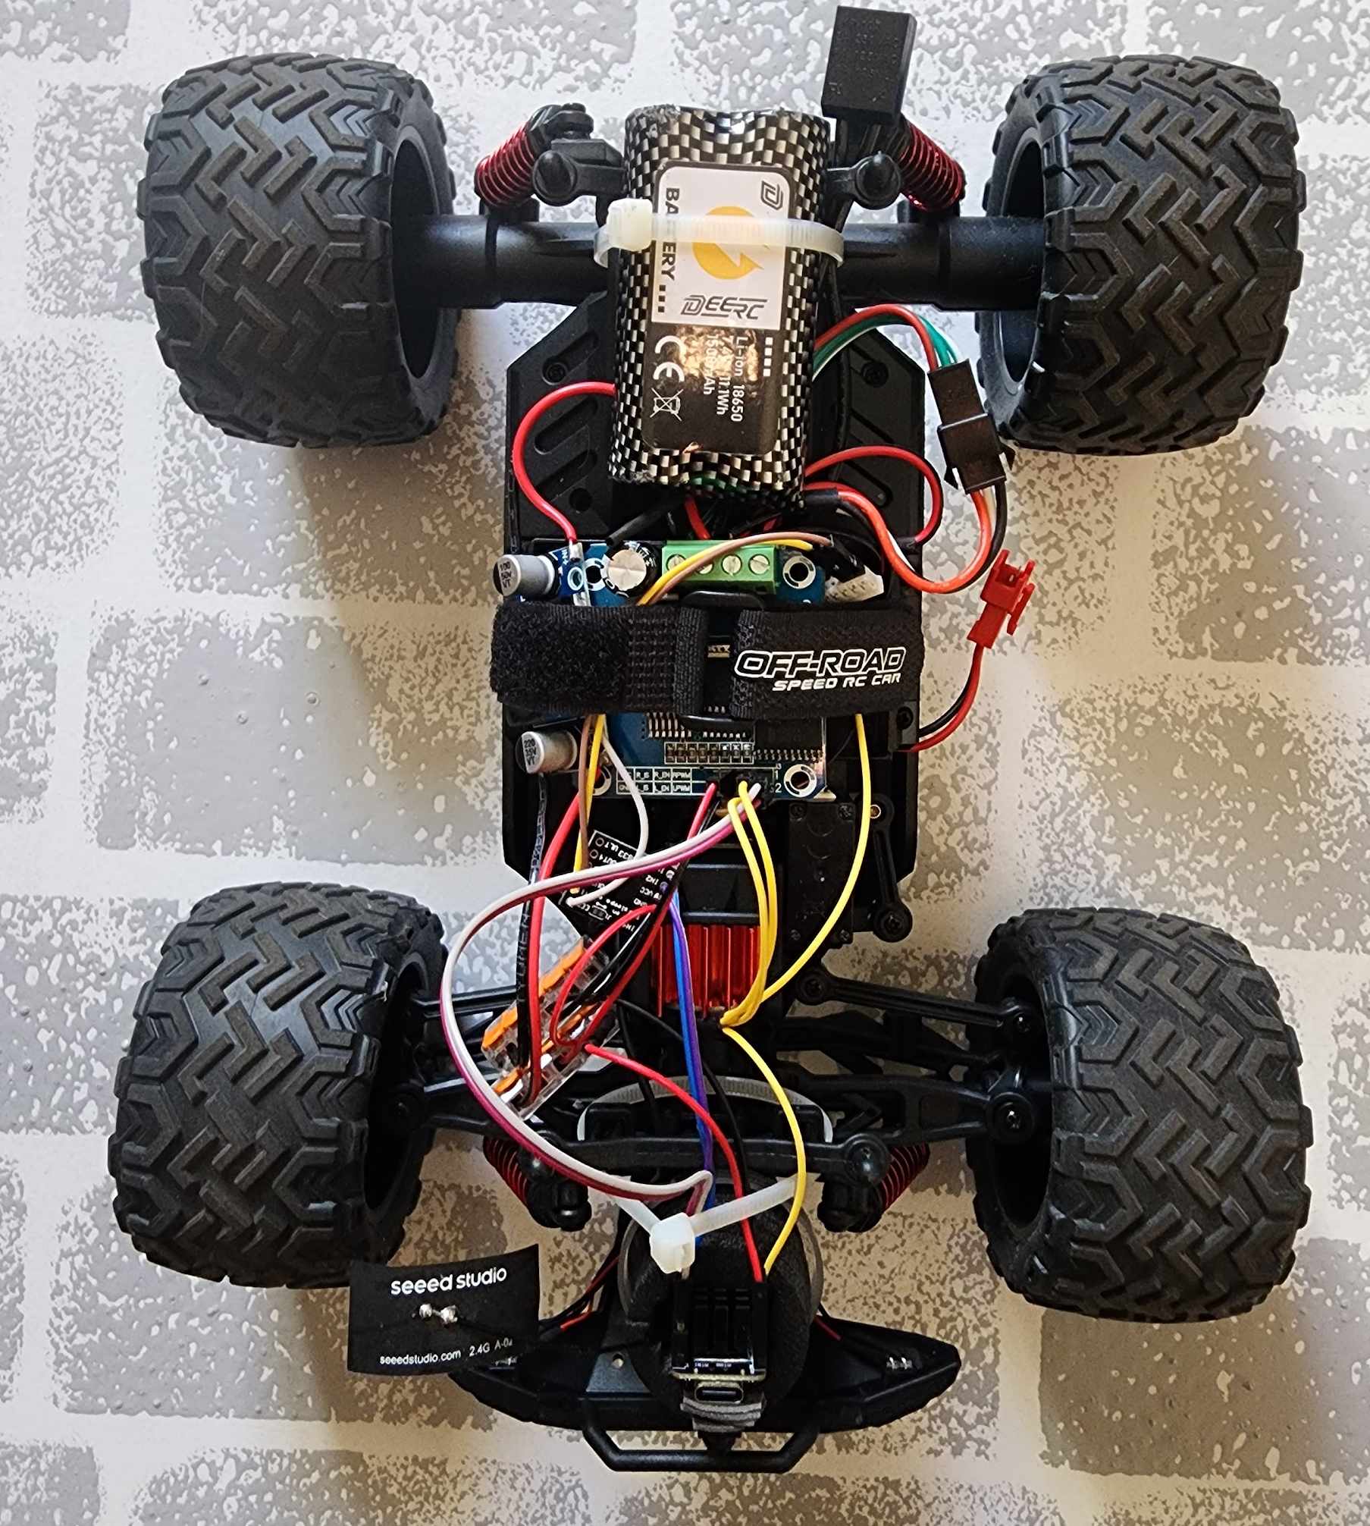

PROJECT OBJECTIVE
GOAL
To design and implement a First-Person View (FPV) Remote-Controlled Car that integrates embedded systems concepts for motor control, wireless communication, and real-time video transmission.
KEY FEATURES
Real-time MJPEG Video Streaming
Browser-based Wireless Control (WiFi)
PWM Motor Speed Control
Low-latency Response

Slide 3





SYSTEM ARCHITECTURE
CLIENT (PHONE)
XIAO ESP32S3
HARDWARE
Browser Interface
Joystick Input
Video Receiver
WiFi Access Point
Web Server
Camera Processing
Motor Drivers
DC Motors
Servo Steering

Slide 4



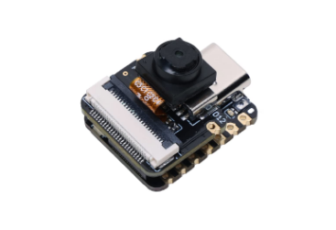
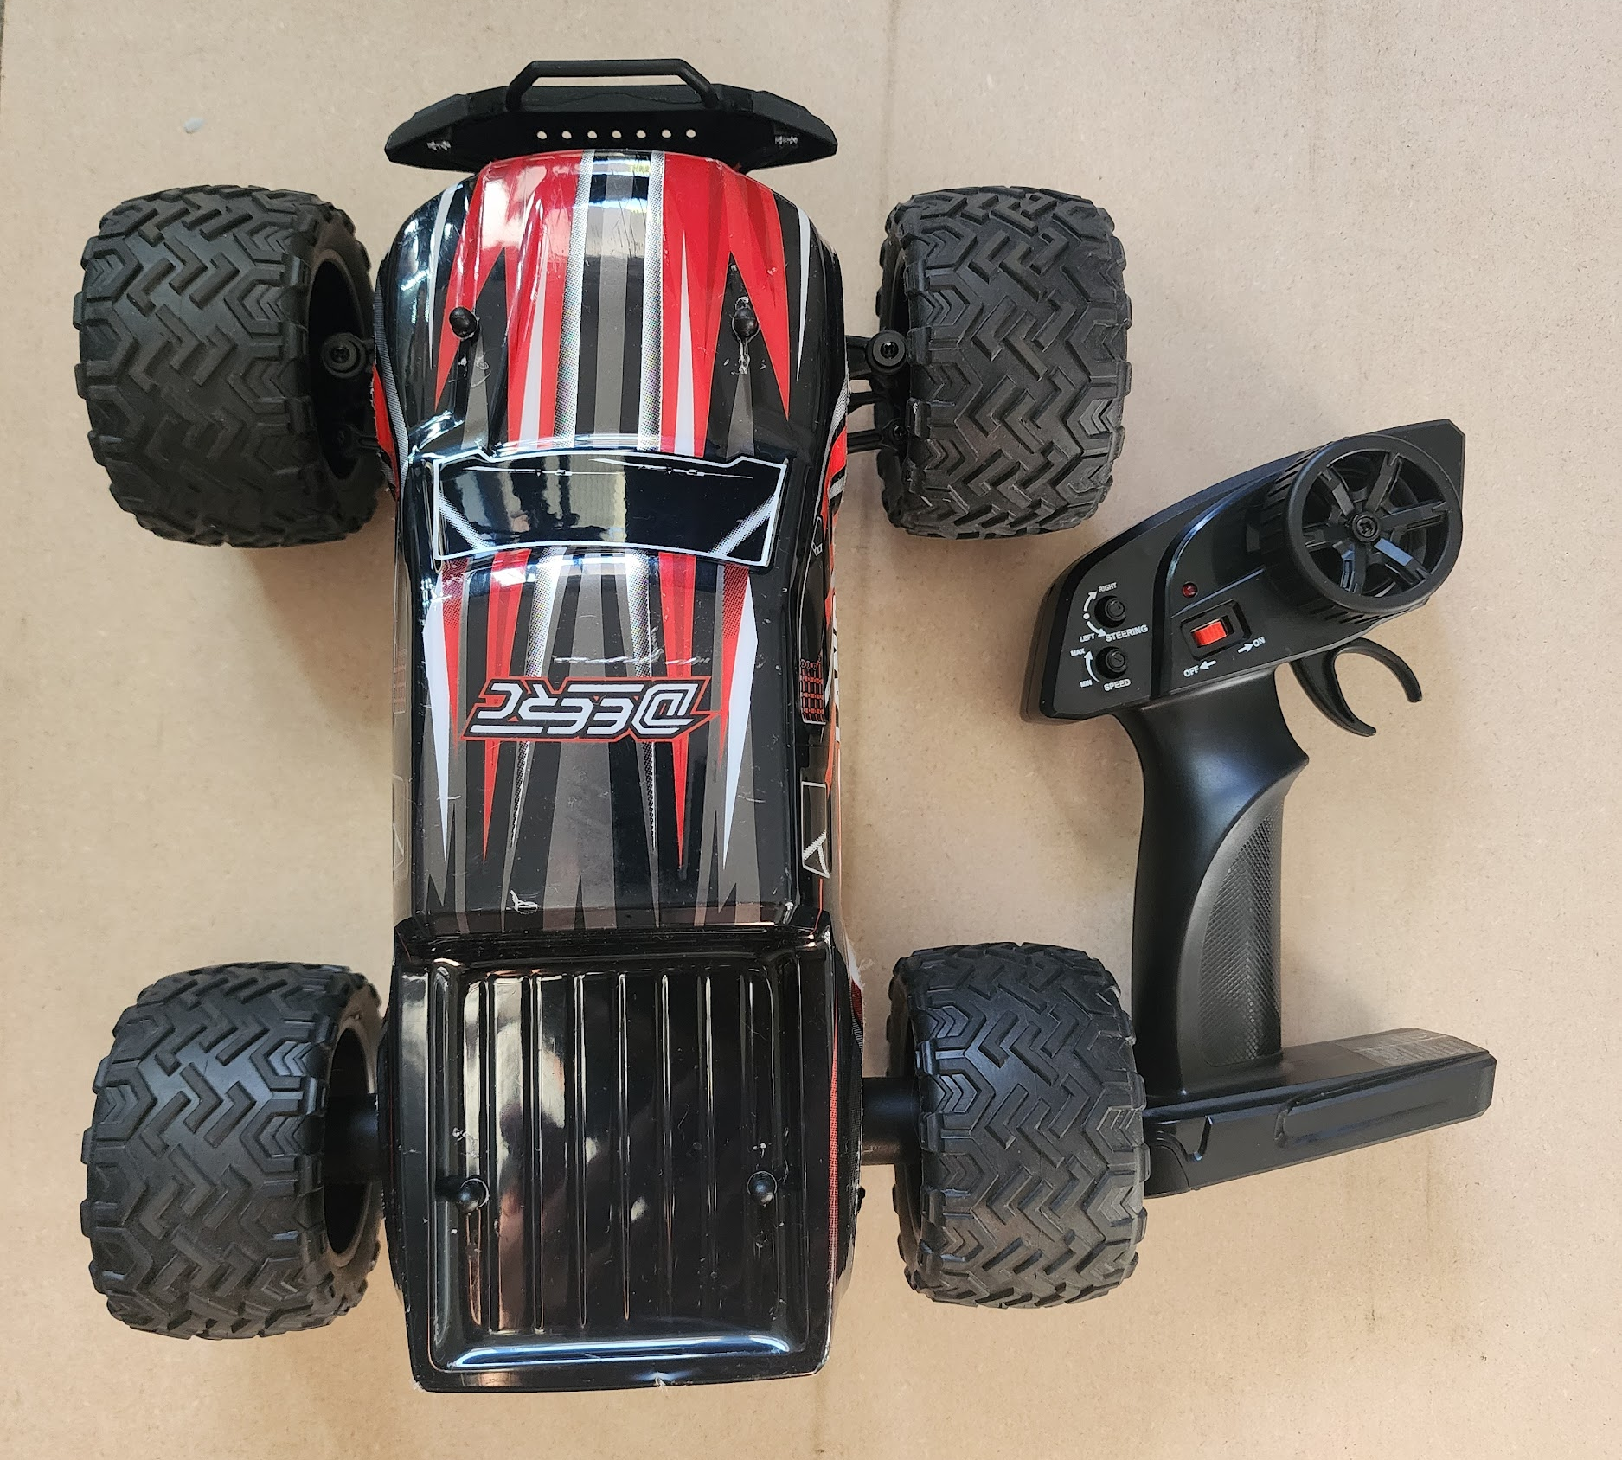
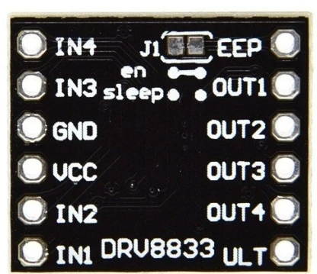
HARDWARE COMPONENTS
CONTROLLER
CHASSIS
ACTUATION
Seeed Studio XIAO ESP32S3 Sense
Amazon RC Car
Motor Drivers:DRV8833 / BTS7960

Slide 5
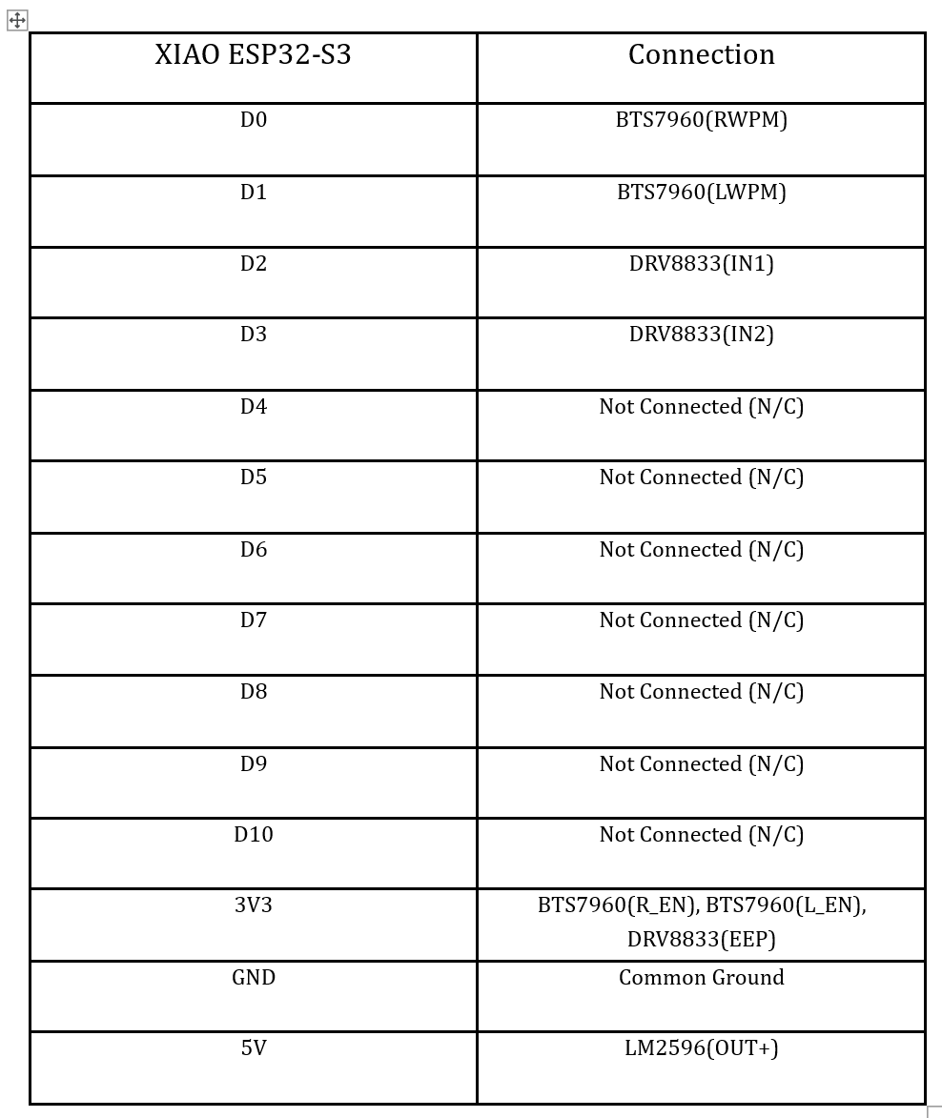
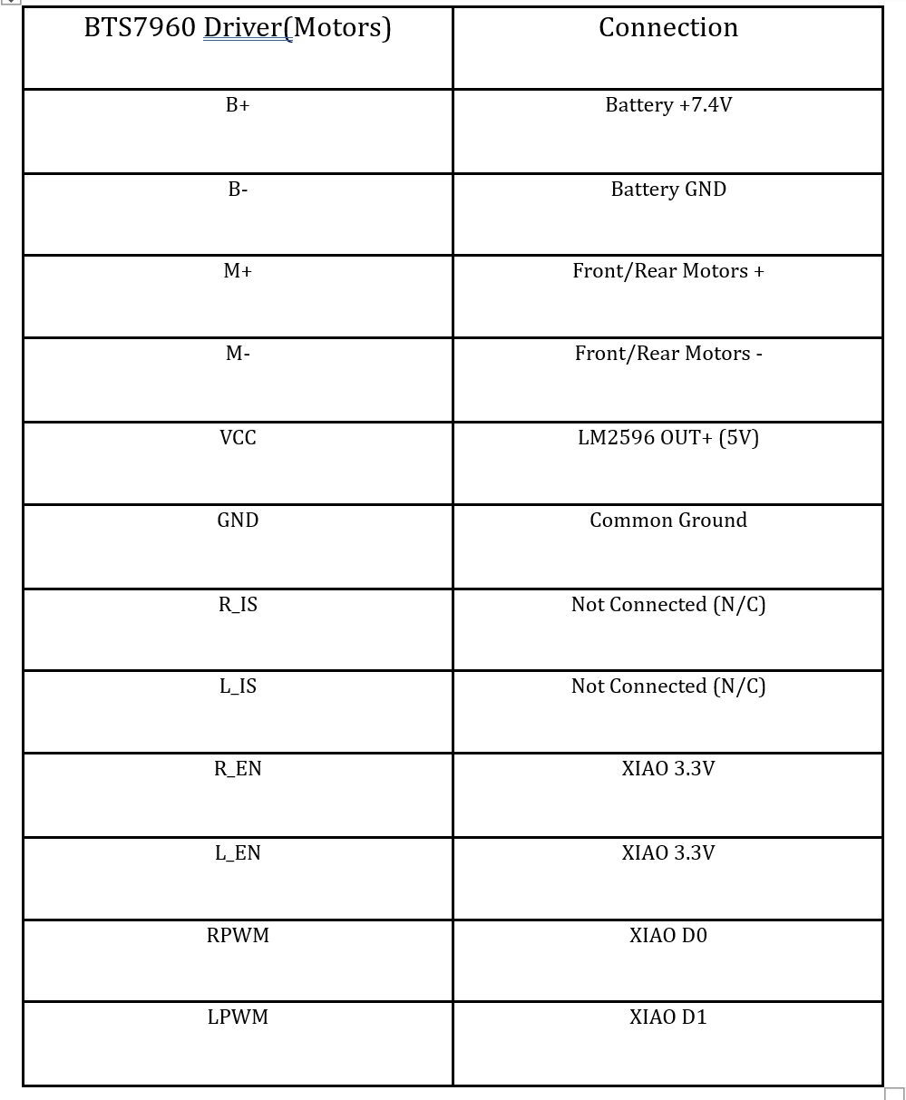
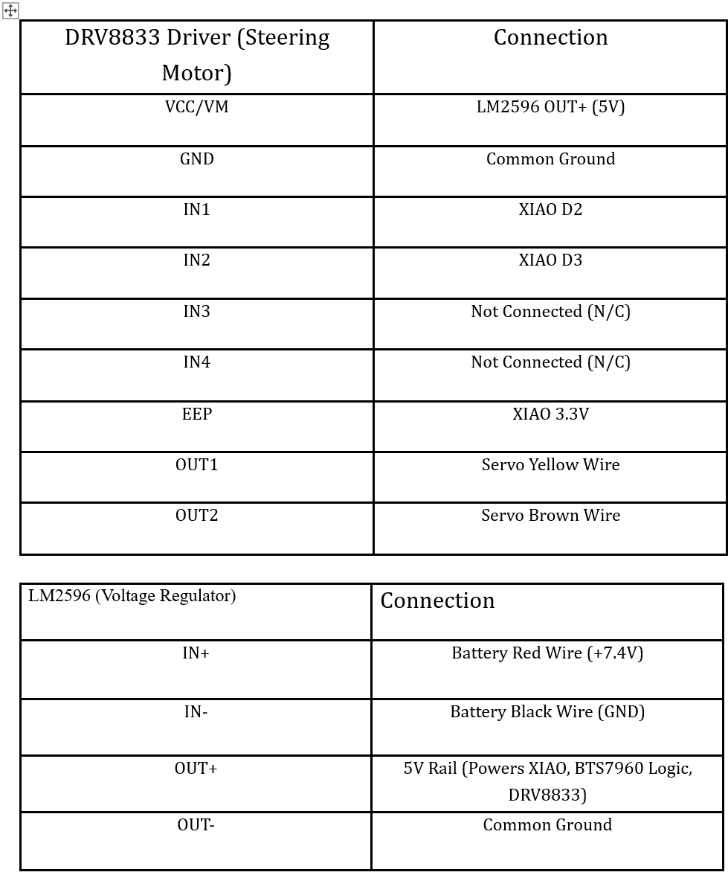
PINOUT CONFIGURATION

Slide 6

Code

Slide 7
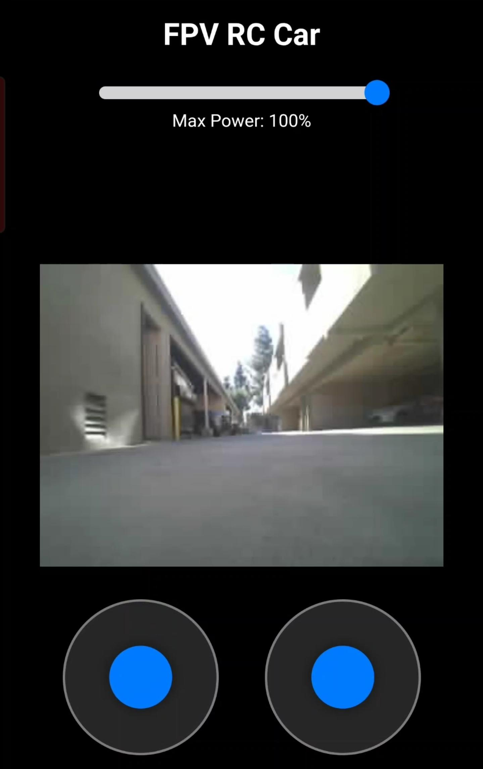
WEB CONTROL INTERFACE
TOUCH INTERACTION
The interface is built using HTML5 & JavaScript, optimized for mobile touchscreens.
Dual Joysticks: Left stick for Throttle (Forward/Back), Right stick for Steering (Left/Right).
Speed Slider: Real-time adjustment of maximum PWM duty cycle (100-255).

Slide 8




LATENCY OPTIMIZATION
FRAME CONFIGURATION
GRAB MODE
To ensure low latency over the SoftAP network, the camera is configured for speed over resolution.
The CAMERA_GRAB_LATEST mode is crucial. It discards older buffered frames, ensuring the user always sees the most current reality, reducing "video lag."

Slide 9
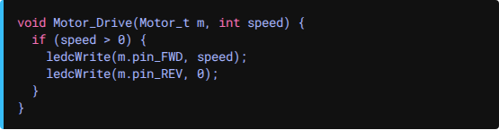
MOTOR CONTROL LOGIC
PWM Implementation: Uses ESP32 ledc peripherals.
DIFFERENTIAL & STEERING
Frequency: 1000 Hz (Standard for DC Motors).
The system supports independent control of drive and steering motors.
Resolution: 8-bit (0-255 values).
Drive Motors: Controlled by variable speed (slider * joystick input).
Steering: Uses max torque (255) to ensure wheels turn fully against friction.

Slide 10




CONCLUSION
The project successfully demonstrates a functional FPV RC car. By leveraging the dual-core capabilities of the ESP32S3 and optimizing the video buffer pipeline, we achieved a responsive, low-latency control system suitable for real-time navigation.
WIFI AP STABLE
LOW LATENCY STREAM
SMOOTH CONTROL

Slide 11
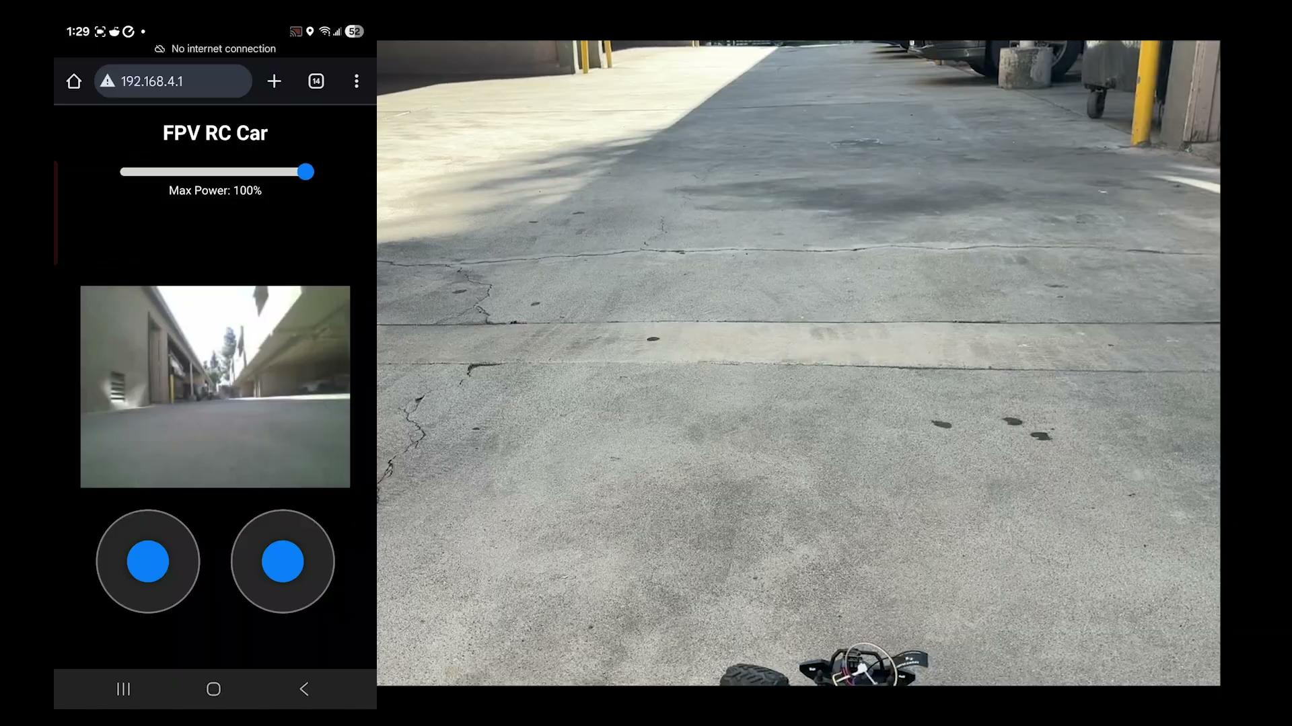
Demo

Slide 12
QUESTIONS?
Thank you for your attention.

